Slide 1





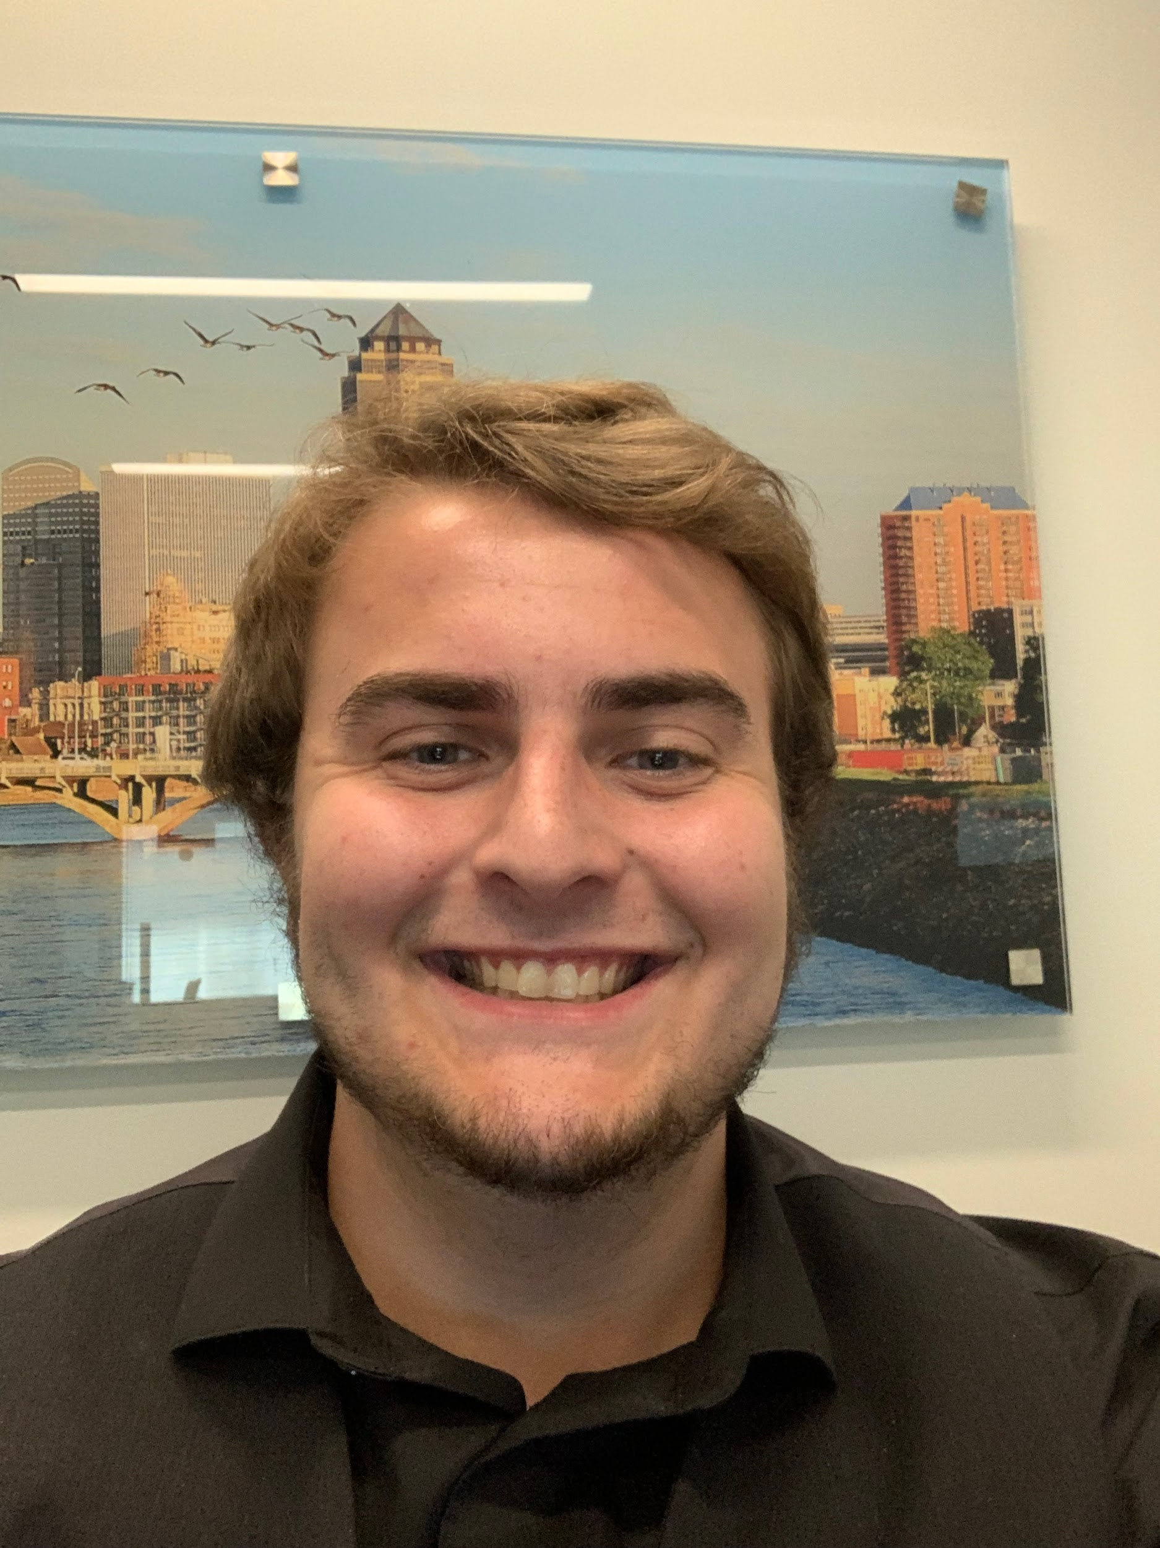
Elisa Chau
Sanjana Addagarla
An ACES solution encouraging positive play experiences
Joe Schaefer
Zachary Eaves
Notes:
Good evening everyone, I am excited to introduce ACES Consulting. My name is Elisa and I am joined by my teammates Sanjana, Zach and Joe. We are excited to showcase our proposal today. EA is looking for solutions to encourage positive play experiences and we are looking forward to assisting you in your journey to creating a healthier gaming environment in EAsports.

Slide 2




EA SPORTS RECOMMENDATION
ASSUMPTIONS
Timeline and financials were calculated based on scaling down full sized projects
EA SPORTS
STRATEGY
Positive Reinforcement
Muting System
Player Ability
IMPACT
40% reduction in online toxicity
15% ROI resulting from year 1 of implementation
EXECUTIVE SUMMARY
POSITIVE REINFORCEMENT
ROLL OUT
FINANCIAL IMPACT
Notes:
EA has already made progress towards creating a positive environment for players. We would like to take further action to provide value by offering three main strategies to reduce online harm. These include utilizing positive reinforcement, a muting system, and finally player ability. Looking at the impact of our cumulative strategy, we estimate that it will result in a 40% reduction in online toxicity and a 15% ROI….

Slide 3

PLAYER PROFILE | TOM B
DEMOGRAPHIC
TARGETS
18-25 year old white heterosexual men
Women
LGBTQ+ community
Players of color
WHAT THEY CARE ABOUT?
NEEDS
Sense of thrill
Sense of accomplishment
Being entertained
Provide incentive
Keep game entertaining
Positive outlet
EXECUTIVE SUMMARY
POSITIVE REINFORCEMENT
ROLL OUT
FINANCIAL IMPACT
Notes:
Before we take a deeper look into our strategy I want to introduce you to Tom B. Tom B is an 18-25 year old white heterosexual man. According to studies by authors from Northeastern University and multiple entertainment companies, Tom is your player who most often commits online harm. His targets usually include players who are women, part of the LGBTQ+ community, and people of color. The study mentioned that players similar to Tom, motivation stems from wanting to feel a sense of thrill and accomplishment, and wanting to constantly be entertained. When looking at ways to discourage or prevent Tom from continuing with online harm is to provide incentive, a new way to keep games entertaining, and having a positive outlet to fulfill their needs and wants. Let’s take a look at the way we chose to combat Tom’s tendency to commit online toxicity.

Slide 4



POSITIVE PLAY EXPERIENCE STRATEGY
WHAT
WHY
HOW
40% reduction in toxicity
Increases enjoyment
Higher levels of retention
Positive reinforcement
Mute feature
Player ability
Utilizing reinforcement
Provide incentives or reward
Equal playing field
EXECUTIVE SUMMARY
POSITIVE REINFORCEMENT
ROLL OUT
FINANCIAL IMPACT
Notes:
In order to resolve Tom’s tendency to commit online toxicity, we present a positive play experience as our strategy. What a positive play experience is composed of utilizing reinforcement, providing a an incentive/reward, and creating an equal playing field. The reason we chose this as our strategy is because research from Spectrum Labs, as shown that it provides a 40% reduction in toxicity. Another study conducted by the International Journal of Serious Games and University of Wyoming found that having a positive environment system increased enjoyment in playing and therefore, led to higher levels of retention. Therefore, we propose of having a positive reinforcement system which will include a mute feature and will also take into accordance of each player ability.

Slide 5
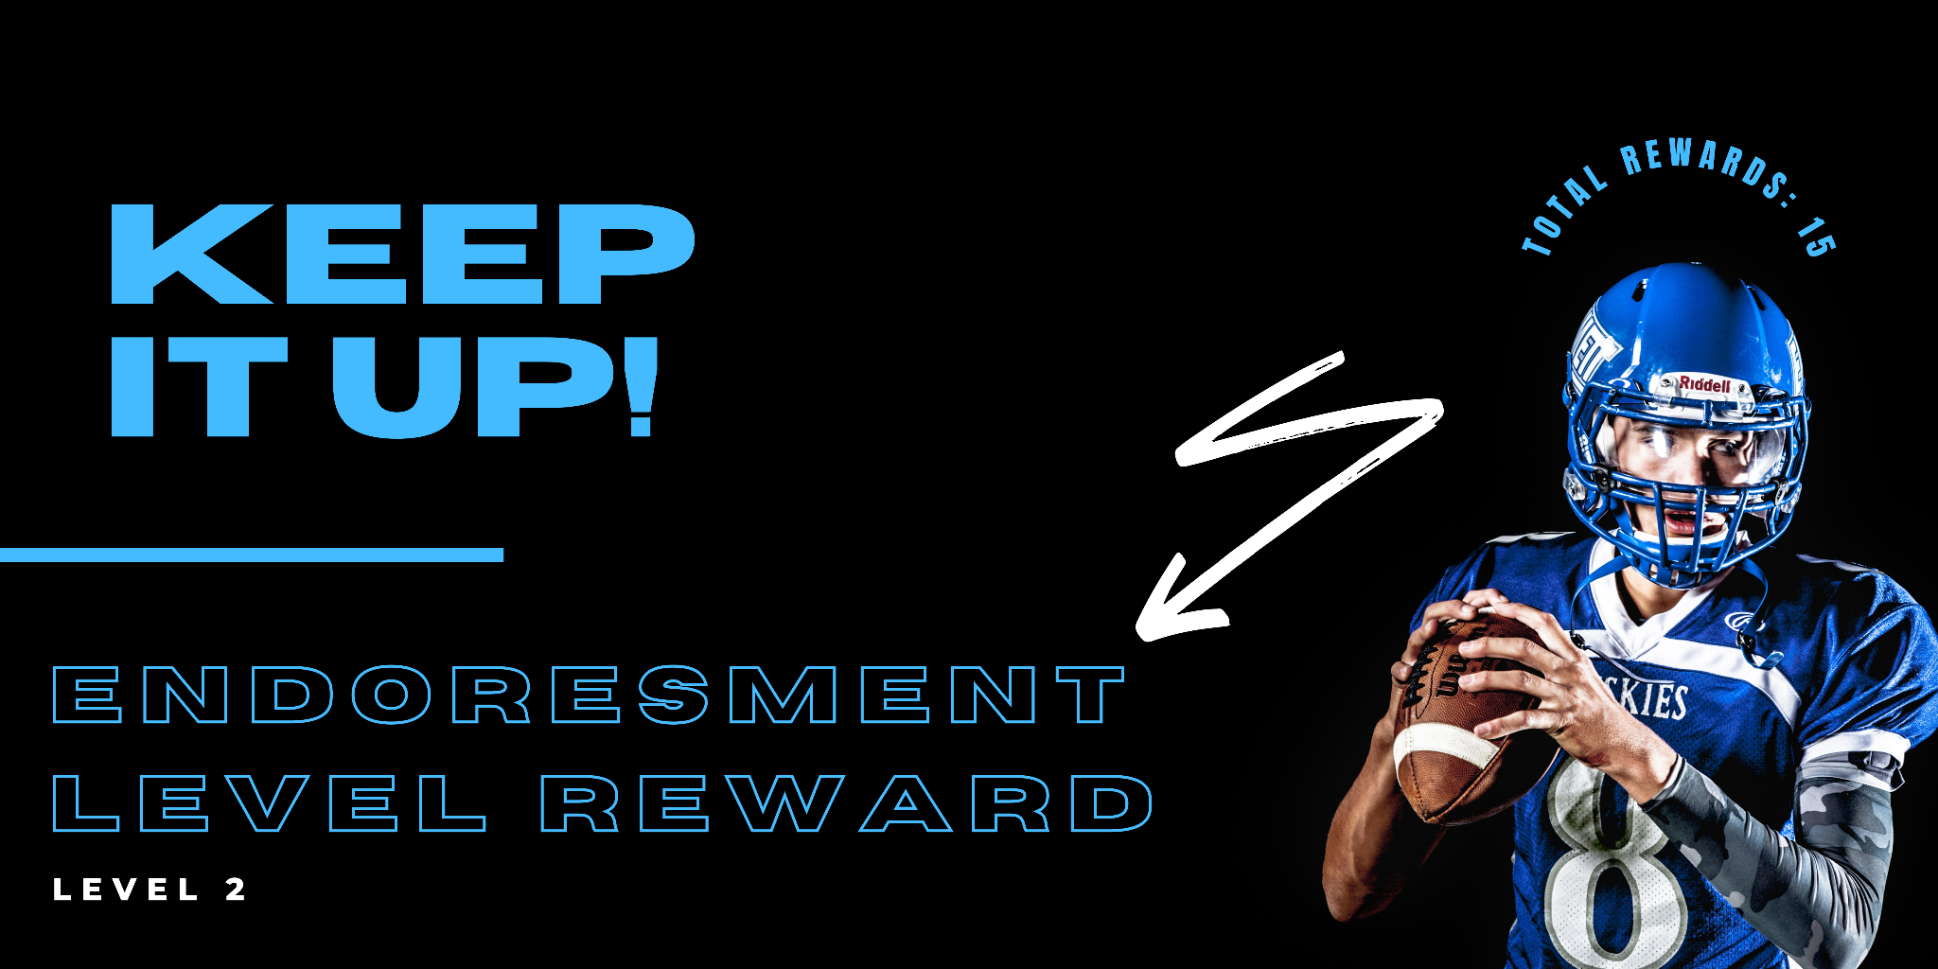
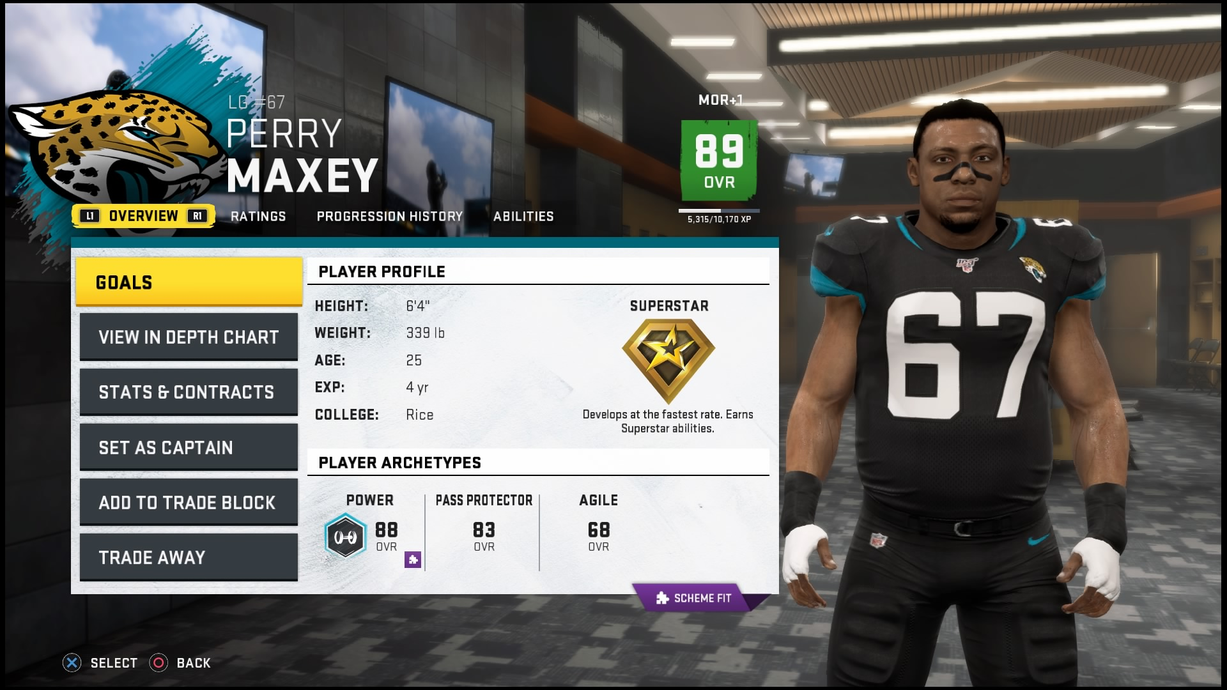



IMPLEMENTATION
POSITIVE REINFORCEMENT
5 level ladder system
Create incentives
Remove endorsements
MUTE FEATURE
Optional mute button
PLAYER ABILITY
Skill based matching
Player statistics & play time
EXECUTIVE SUMMARY
POSITIVE REINFORCEMENT
ROLL OUT
FINANCIAL IMPACT
Notes:
Now going into more depth on how we will roll this out is by starting a positive reinforcement system. This system was influenced by an implementation in the game console League of Legends.
The positive reinforcement works by having 5 levels and each level has three different checkpoints. At each checkpoint players can receive rewards such as; new jersey, unlocking a new stadium, and screen flairs.
Players will also have the option of having a mute button. This will allow a player to mute another if they are participating in any negative language or verbal behavior that is harmful.
In addition, players will be able to play a game based on their abilities. In order to determine a player’s skill level we will measure their overall performance on winning statistics and how long/much the play on a daily basis.
So now let’s take a look at our estimated timeline.

Slide 6
IMPLEMENTATION TIMELINE
10 month
3 month
2 month
2 month
5 month
Dec 2022
Oct 2023
Jan 2023
Mar 2024
May 2024
Oct 2024
Planning & Pre-Production
Production
Testing
Pre-Launch
Launch
Post Production
Estimated Completion Time: 24 Months
EXECUTIVE SUMMARY
POSITIVE REINFORCEMENT
ROLL OUT
FINANCIAL IMPACT
Notes:
Now looking at the implementation timeline, we estimate that this project will take a total of 24 months to complete. This is based on a full-scaled gaming development brought down to a shorter timeline to accommodate for a smaller project. If beginning the project today, we estimate that planning and pre-production would finish in dec. Following that is production with the longest duration of time of 10 months to accommodate for development of our features. Following production, is the testing of the code. When it’s passed, it moves onto the launching stages and finally allowing for any additional fixes after the main launches is the post production changes and edits.

Slide 7
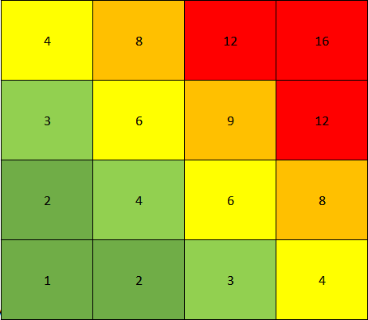




RISKS HEATMAP
Serious
Experience Backfire(8)
Further Report Abuse(12)
Competitive Degradation(2)
Insufficient Rewards(6)
Least Concern
Impact -
Probability - Unlikely Very Likely
EXECUTIVE SUMMARY
POSITIVE REINFORCEMENT
ROLL OUT
FINANCIAL IMPACT
Notes:
Why did we choose not pursue a competitive preference
Mock ups of what a player might see
KPI’s for different areas of churn,

Slide 8
FINANCIAL IMPACT
RECOUPED REVENUE
2.5 % INCREASE IN REVENUE
Investment of 1.5 Million Dollars
DECREASE IN OPERATING EXPENSE
3 % DECREASE IN EXPENSE
RETURN ON INVESTMENT
15 %
EXECUTIVE SUMMARY
POSITIVE REINFORCEMENT
ROLL OUT
FINANCIAL IMPACT
Notes:
Magnitude of the dollar to EA - toxicity leads to players leaving

Slide 9
STRATEGY IMPACT
ASSUMPTIONS
Timeline and financials were calculated based on scaling down full sized projects
EA SPORTS
STRATEGY
Positive Reinforcement
Muting System
Player Ability
IMPACT
40% reduction in online toxicity
15% ROI resulting from year 1 of implementation
EXECUTIVE SUMMARY
POSITIVE REINFORCEMENT
ROLL OUT
FINANCIAL IMPACT
Notes:
ACES is confident this strategy will reduce online harm in EAsports. Through the implementation of positive reinforcement, muting system, and player ability, EAsports will see a 40% reduction in online toxicity and 15% ROI resulting from year 1 of implementation. ACES is honored to be a part of EA’s journey as they continue to encourage positive gaming experiences. And if you remember our player, Tom B, he is now able to have a positive outlet to continue gaming without causing harm to other players. We now welcome any questions you may have.

Slide 10
APPENDIX MAP
Slide 1: ACES Consulting
Slide 2: Executive Summary
Slide 3: Player Profile
Slide 4: Positive Play Strategy
Slide 5: Implementation
Slide 6: Timeline
Slide 7: Risk Heatmap
Slide 8: Financial Impact
Slide 9: Impact
Slide 11: Player Profile
Slide 12: Strategy
Slide 13: Strategy
Slide 14: Timeline
Slide 15: Risk
Slide 16: Financial Impact

Slide 11
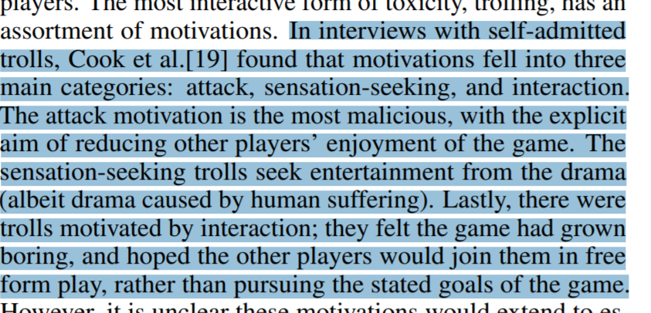
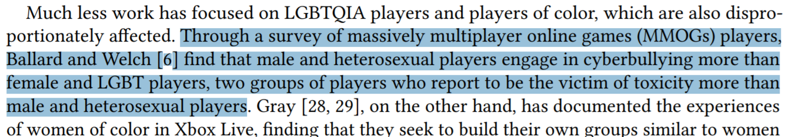
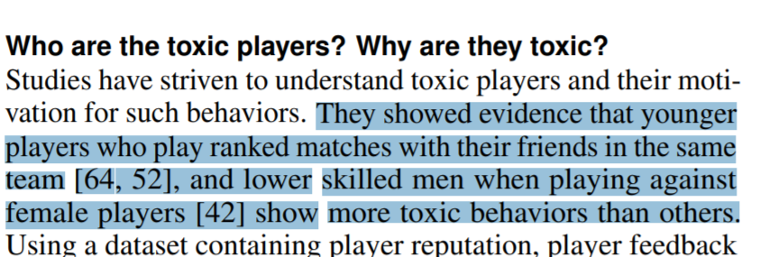
APPENDIX
Customer Profile
https://dl.acm.org/doi/pdf/10.1145/3313831.3376191 (see no evil, hear no evil)
https://dl.acm.org/doi/pdf/10.1145/3474680 (for honor, for toxicity)

Slide 12
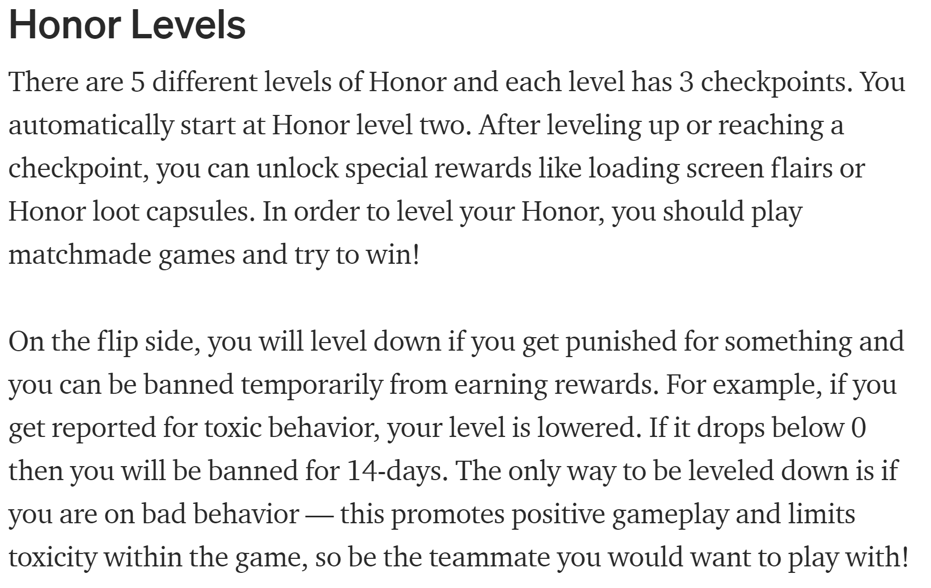
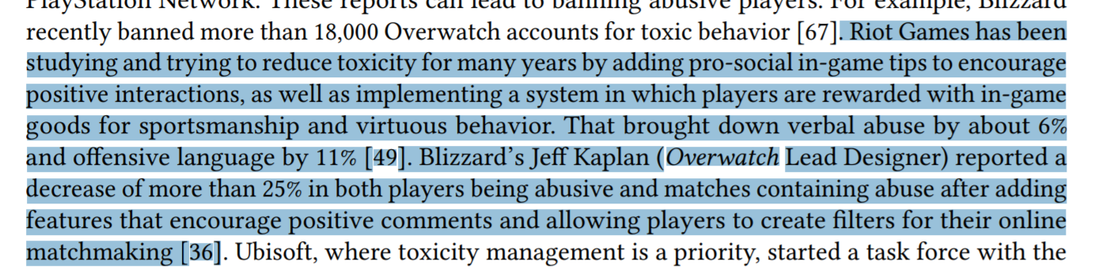
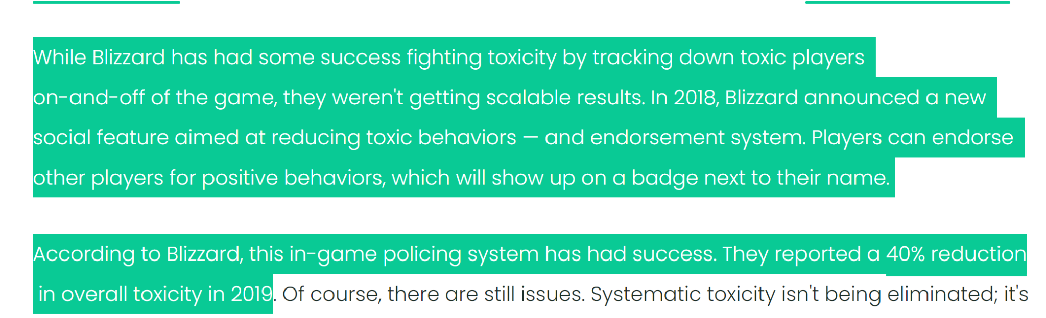
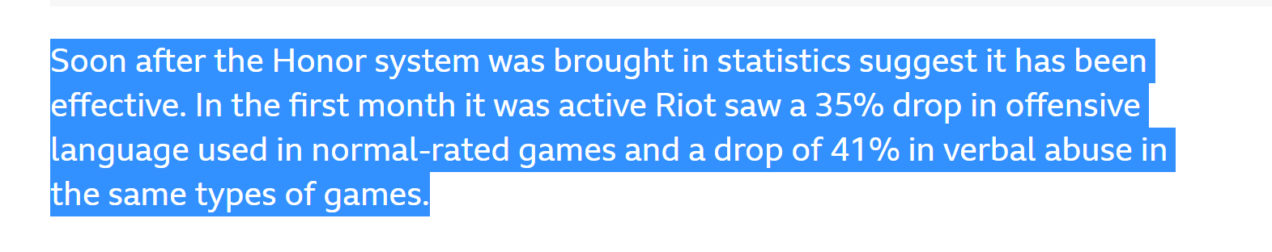
APPENDIX
https://leon-40960.medium.com/league-of-legends-honor-system-e134022fcef0
Strategy
https://dl.acm.org/doi/pdf/10.1145/3474680
https://www.spectrumlabsai.com/the-blog/how-major-gaming-companies-are-combatting-toxicity-in-2020
https://www.bbc.com/news/technology-20204354
https://citeseerx.ist.psu.edu/viewdoc/download?doi=10.1.1.679.5307&rep=rep1&type=pdf

Slide 13
APPENDIX
Strategy
-verification system-game then performs a validation check on the command to see if the player, make sure move is legal (https://www.gamasutra.com/view/feature/3149/how_to_hurt_the_hackers_the_scoop_.php?print=1)
-muting system
-positive reinforcement- through honor system - (https://dl.acm.org/doi/pdf/10.1145/3270316.3271545)
https://leon-40960.medium.com/league-of-legends-honor-system-e134022fcef0
https://www.spectrumlabsai.com/the-blog/how-major-gaming-companies-are-combatting-toxicity-in-2020 - Blizzard uses and has seen 40% reduction of toxicity, talks about muting and using AI to monitor chat logs
https://citeseerx.ist.psu.edu/viewdoc/download?doi=10.1.1.679.5307&rep=rep1&type=pdf - player centered positive reinforcement increases enjoyment and performance

Slide 14
APPENDIX
Timeline
https://www.g2.com/articles/stages-of-game-development
https://www.cgspectrum.com/blog/game-development-process
Planning - 1 producer, 1 developer, 1 concept artist
Production - 2 writers, 1 artists, 1 designers, 5 developers, 3 engineers, 1 project leads
Testing - 2 test engineers
Pre-launch - using marketing team resources
Launch - using marketing team resources
Post production - 1 producer, 2 developer, 2 engineers 1 concept artist

Slide 15
APPENDIX
Risks
Potential to Backfire on player experience (L2, I4)
Too many penalties or controls might make a passionate gamer consider other games
Actual toxic players may abuse our report system, and consequently shut out good natured players from rewards (L4, I3)
Riot, Valve, EA all have had problems with report transparency
Potential to reduce the size of competitive scene(L1, I2)
Could affect key marketers such as streamers
Rewards for positive behavior may not be enough or be insufficient(L2, I3)
We assume that we made need to change
EXECUTIVE SUMMARY
POSITIVE REINFORCEMENT
ROLL OUT
FINANCIAL IMPACT
Notes:
Why did we choose not pursue a competitive preference
Mock ups of what a player might see
KPI’s for different areas of churn,

Slide 16
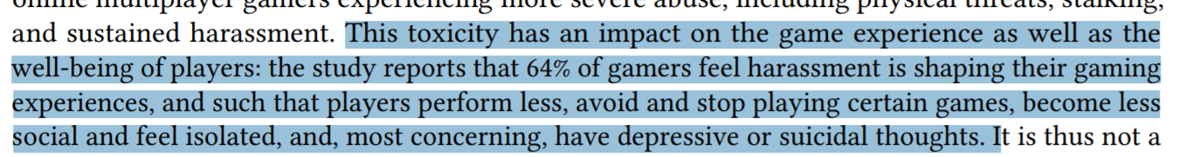
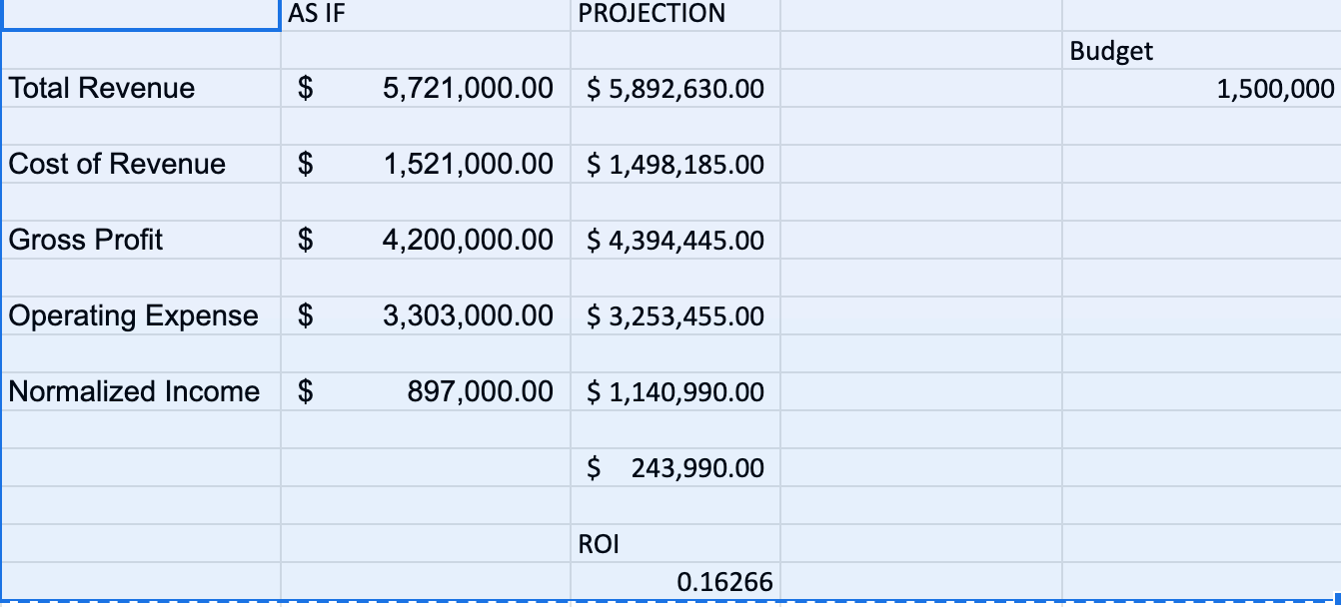
APPENDIX
Financial Impact
Magnitude of the dollar to EA - toxicity leads to players leaving game
https://www.gamerspeak.io/dont-hesitate-take-action-and-ban-toxic-players/
https://finance.yahoo.com/quote/EA/financials?p=EA
https://www.adl.org/free-to-play
https://msutoday.msu.edu/news/2021/faculty-voice-gaming-and-toxicity?collection=b5aeb011-2fbb-411f-9179-81bb58d9936e
https://www.wired.com/story/toxicity-in-gaming-is-dangerous-heres-how-to-stand-up-to-it/
https://dl.acm.org/doi/pdf/10.1145/3474680

